Slide 1


“I had no idea Quizizz could do that.”
Almost everybody
Create and deliver bell-to-bell curriculum resources that meet the needs of every student.
Notes:
COVER

Slide 2

Where we started
Gamified quizzes

Slide 3





Instructional Suite
Assessments
Lessons
Passages
Interactive Video
Flashcards

Slide 4
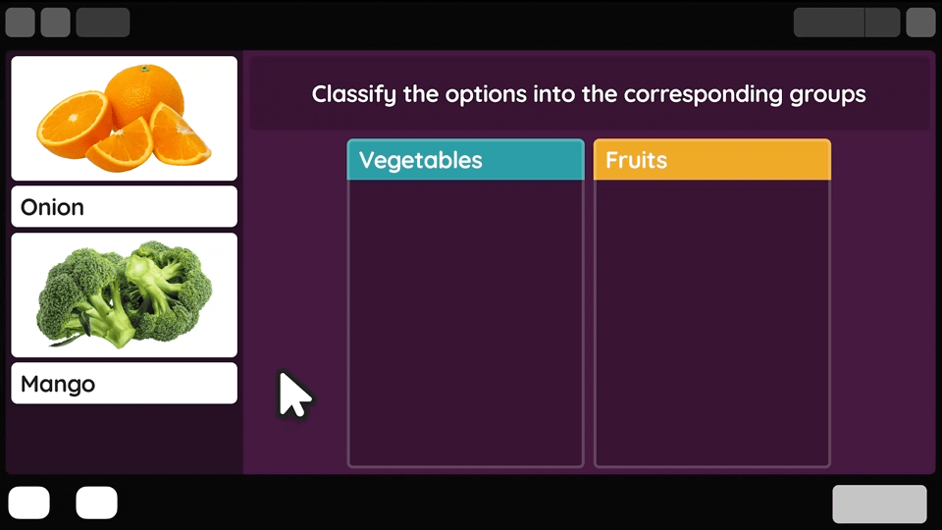
Assessments
18+ question types
Search by standard
Practice, test, and gamification modes

Slide 5
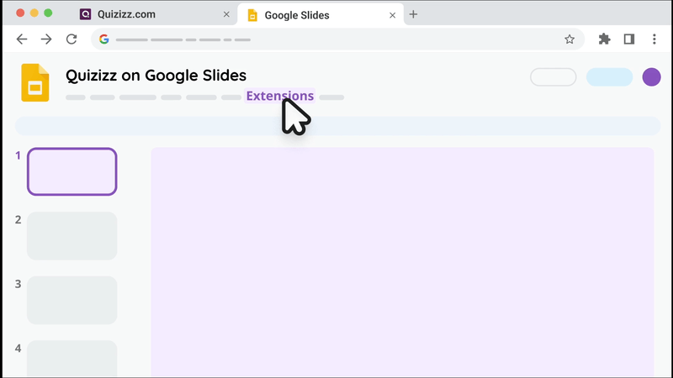
Lessons
Google Slides Add-on
Lessons toolbox
Improved formative data

Slide 6
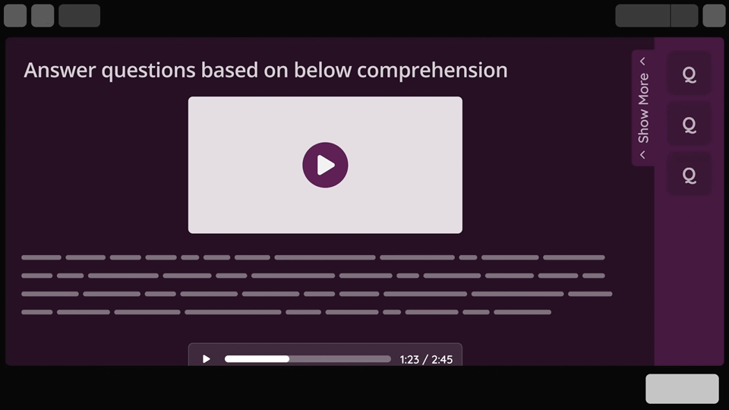
Passages
Incorporate literacy across the curriculum
Create questions from your favorite reading material
Standardized test prep

Slide 7
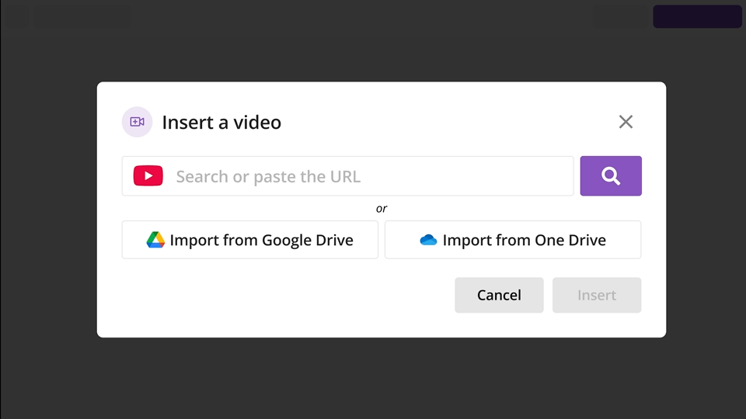
Interactive
Video
Create even quicker with AI generated questions
Reteach concepts
Assign as homework

Slide 8




















20+ media and question types
Passages
Labeling
Math Response
Audio Response
Match
Categorize
Reorder
Open-Ended
Draw
Interactive Video
Graphing
Drag and Drop
Poll
Drop Down
Word Cloud
Video Response
Fill in the Blank
Slide
Multiple Choice
Hotspot

Slide 9




Turn ideas into instruction in seconds
Generate activities in seconds from your favorite YouTube videos, PDFs, and educational websites with the Chrome Extension
Increase efficiency and digitize your core curriculum, images and all, with AI Worksheets to Activities
Create the right reading material, in minutes with AI-generated Passages
Get instant data to identify skill gaps and give personalized practice recommendations with AI Analyze

Slide 10




Close gaps, open doors with accommodations
Ensure technology is compliant with 25+ accessibility features including Read Aloud, Audio Responses, Translation, Dyslexia Font, and more
Reduce specific barriers and assign unique accommodations to any student
Increase flexibility in the way information is presented and align to UDL frameworks
Adapt content to meet student needs by creating multiple versions of the same activity with unique reading levels and more

Slide 11




Teach flexibly, all in one place
Build instruction for any subject, grade level, lesson,
assessment, or activity with unlimited storage
Strengthen instructional consistency with Co-Teaching, a shared library, and teams for PLCs, grade levels, subject areas
Create consistency for students with the same tech across different classrooms, subjects, and grade levels
Give teachers a singular platform they actually use and coaches
or curriculum experts a single platform to support

Slide 12




Engage students without sacrificing rigor
Promote higher-level thinking with 20+ question types from state
tests including Passages, Math Responses, Drawing, and more
Adapt instruction based on student data with longitudinal growth reports and standards-based reporting
De-stress testing and standardized test prep with Focus Mode and Review & Submit
Motivate students with Power-Ups, Leaderboards,
Team Mode, and more gamified elements

Slide 13
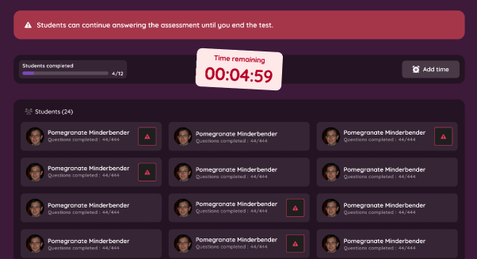
Common Assessments
Assess student progress across schools
Increase consistency, equity, and fairness in student learning experiences
Improve student achievement through team-developed common assessments
Determine if students are learning the district curriculum by comparing results to benchmarks and standards
Notes:
Funds should address learning loss for each and every students—students who are

Slide 14

Right to Win
Consolidation of multiple educational tools into a single platform
Curriculum-agnostic and supports content from kindergarten to college
The platform supports 52 languages with 25 language interface options
Integrate seamlessly with major Learning Management Systems like Google Classroom, Microsoft Teams, Canvas, Moodle, Schoology
Notes:
What LMS are you using? What privacy needs does your district have?

Slide 15
Thank You!

